Slide 1
ONLINE FITNESS MANAGEMENT SYSTEM
SUBMITTED BY-
DHARAMPREET SINGH (2001215)
DHARMINDER SINGH (2001216)
DILJOT SINGH (2001217)
DILSHAD AHMAD (2001218)

Slide 2
AIM OF THE PROJECT
So, We are developing a website to overcome some of these issues. So this project can be helpful for Fitness lovers.
In this website, we provide Online Meal plan and Online Fitness workout classes
This website can be elaborated by providing diet information, personal training etc.
Every member handle the diet maintenance with once registration and also provide a personal training for each and every members.

Slide 3
OBJECTIVE OF THIS PROJECT
The objective of this system is to digitalize and create an automated system. The system will perform the task like adding the new member, removing the member or keeping the payments records and other stuff.
Automating the existing system.
Reducing time taken to enter client and staff data.
To centralize the management of fitness center.
Reduce data loss in the manual system already in place.
Make data retrieval easy and reduce time wasted when manually searching for data.

Slide 4

SOFTWARE AND HARDWARE REQUIREMENTS
HARDWARE REQUIREMENTS:
Processor : intel 3
Ram :1 gb ddr2 ram
Hard disk drive : 160 gb
SOFTWARE REQUIREMENTS:
Front end : html5, css3,
Back end : php, mysql
Control end: angular java script
PHP TOOLS:
xampp-win32-5.5.19-0-VC11

Slide 5
EXISTING SYSTEM
The gym is working manually. The current system is time consuming and also it is very costly, because it involves a lot of paperwork. To manually handle the system was very difficult task. But now-a-days computerization made easy to work. The following are the reasons why the current system should be computerized:
To increase efficiency with reduced cost.
To reduce the burden of paper work.
To save time management for recording details of each and every member and employee.
To generate required reports easily.

Slide 6
PROPOSED SYSTEM
The proposed system is used for stores records of the system.
It is easier to find the user names, workout timings, meal plan etc.
Time table is orderly arranged. It has implemented an information of about the online sessions and schedule of workout days and also schedule of daily diet for every members.

Slide 7
ADVANTAGES OF PROPOSED SYSTEM
The proposed system is highly secured, because for login the system it requires the username and password which is different for each department therefore providing each department a different view of the customer information.
It provides wide range of certain criteria in each window the client is working for better and quicker solution.
It maintains report for all criteria and transactions.
Manages member information separately for all bill information separately for considering the requirement of gym.
Stores information about regular products.
Diet recommendation

Slide 8
MODULE LIST
ADMINISTRATOR
Login
Add Member
Update/Delete Members
Assign Notification for monthly
Report export
Diet Details
USER
Login
View diet
View schedule

Slide 9
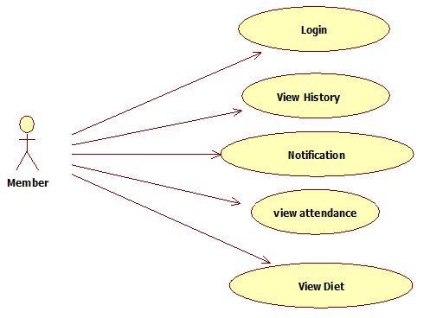
USECASE DIAGRAMS
USER

Slide 10
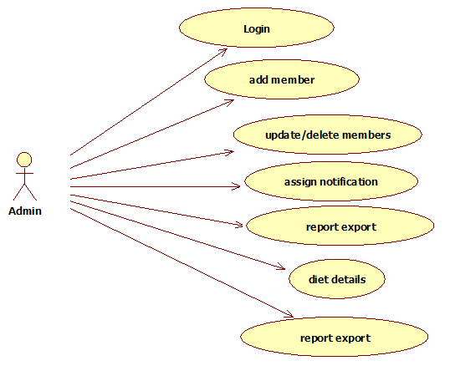
ADMIN

Slide 11
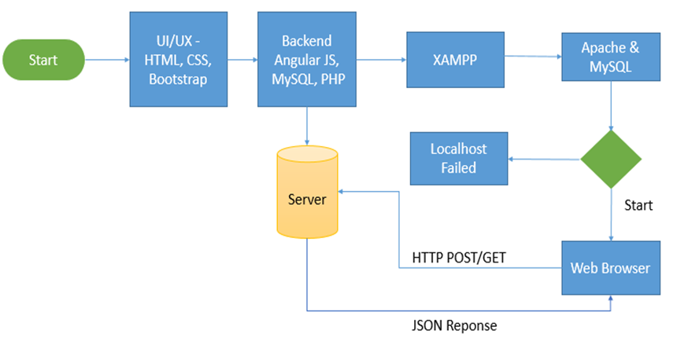
WORKFLOW DIAGRAMS

Slide 12
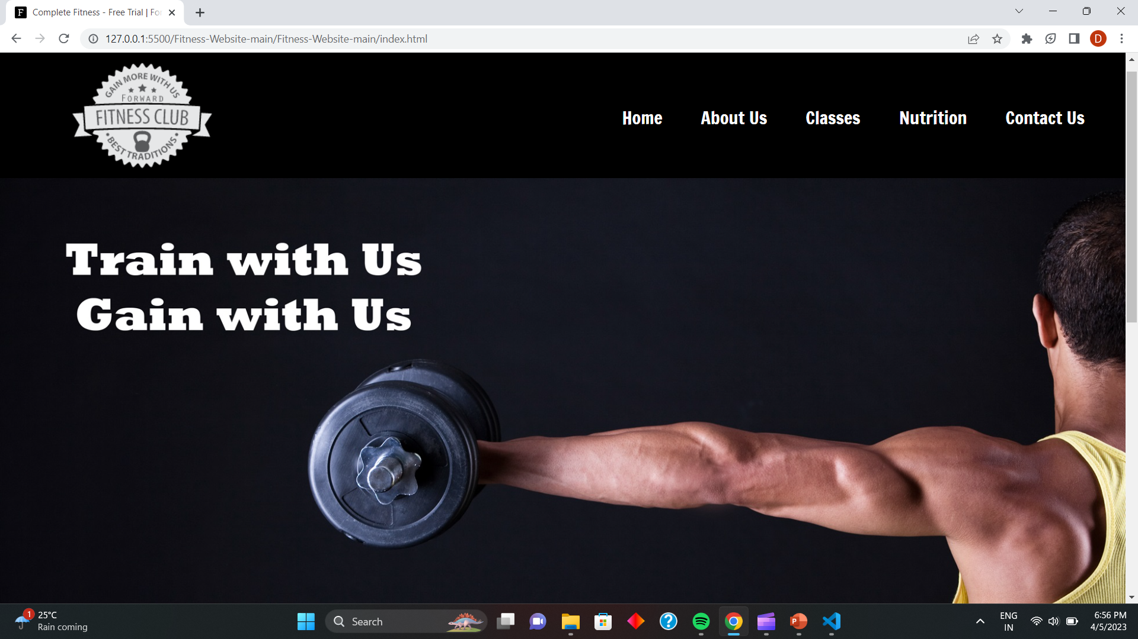
SCREENSHOTS

Slide 13
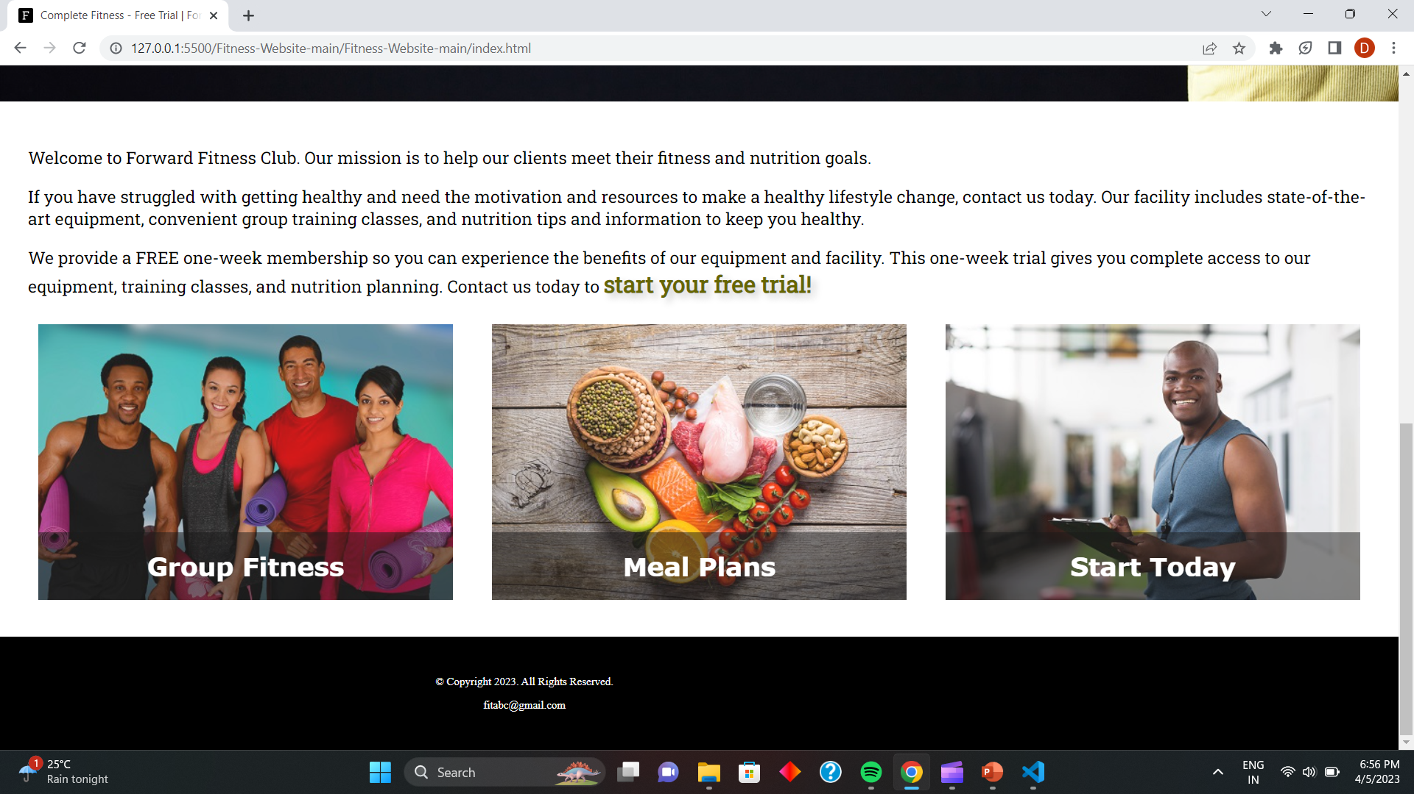

Slide 14
CONCLUSION
The “GYM MANAGEMENT SYSTEM” is successfully designed and developed to fulfilling the necessary requirements, as identified in the requirements analysis phase, such as the system is very much user friendly, form level validation and field level validation are performing very efficiently.
The new computerized system was found to be much faster and reliable and user friendly then the existing system, the system has been designed and developed step by step and tested successfully.
It eliminates the human error that are likely to creep in the kind of working in which a bulk quantity of data and calculations as to be processed.
The system results in quick retrieval of information that is very vital for the progress any organization. Cost is minimized in case of stationary.
Burden of manual work is reduced as whenever transaction takes place, there is a no need to record it in many places manually.

Slide 15
FUTURE ENHANCEMENT
In future, It can be summarized that the future scope of the maintaining information regarding
We can add printer in future
We can giver more advance software for gym management system including more facilities
We will host the platform on online servers to make it accessible worldwide
Now this project maintain the records of Gym and attendance.
Real-time chat Bot option for members and trainers, so that members can directly enquiry theirs trainer on any time through the chat BOT.
Automated fitness suggestions by enquiring the condition of the health.
Video conversation option for trainers and members.
Barcode generation for membership card and using this members can take entry the gym.

Slide 16
REFERNECES

Slide 17
THANK
YOU

